Slide 1

SETU Code Lab
Diarmuid O’Neill
24/10/2025

Slide 2
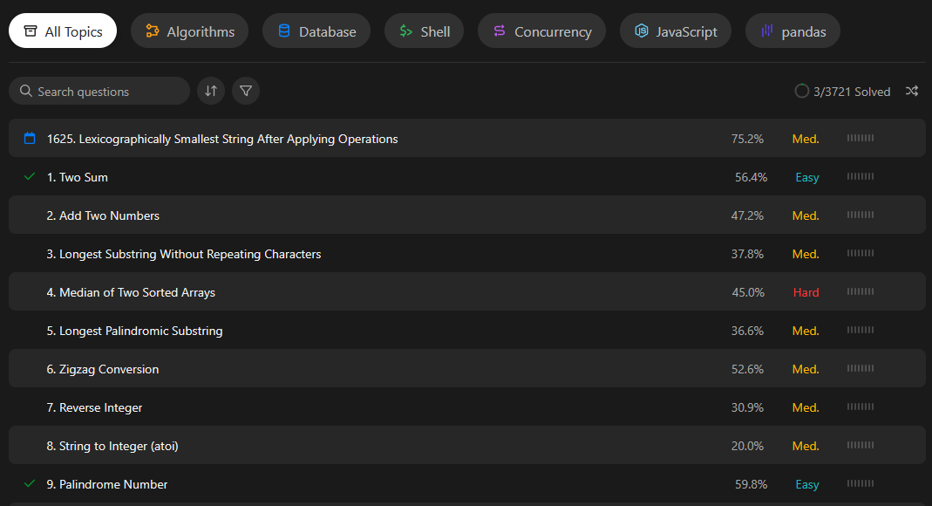
Overview
What is it?
How does it work?
What exists already?
How is SETU Code Lab different?
Fig. 1. List of code problems on LeetCode Source: (LeetCode, 2024)

Slide 3
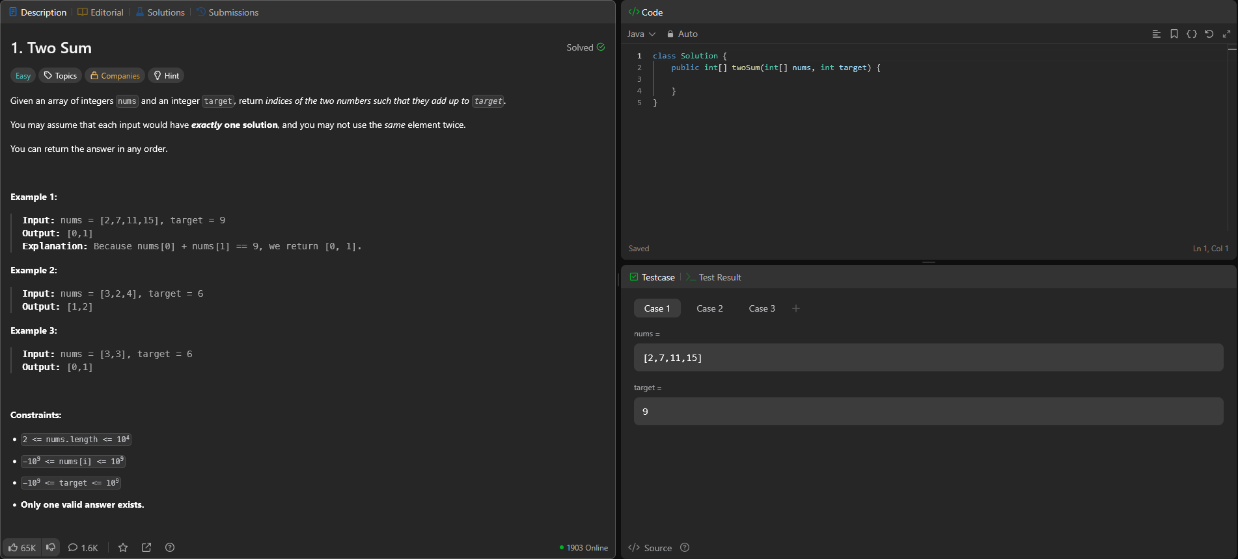
Fig. 2. Code problem page Source: (LeetCode, 2024)

Slide 4







Technologies
Front-End
Back-End
Database

Slide 5
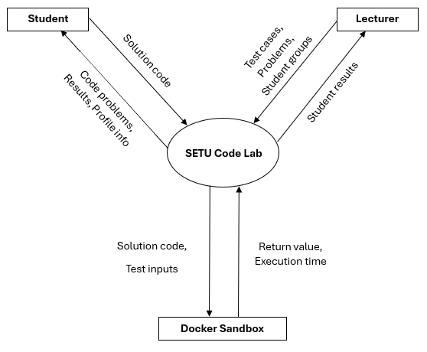

Code Sandboxing
What is code sandboxing?
How will you implement code sandboxing?

Slide 6
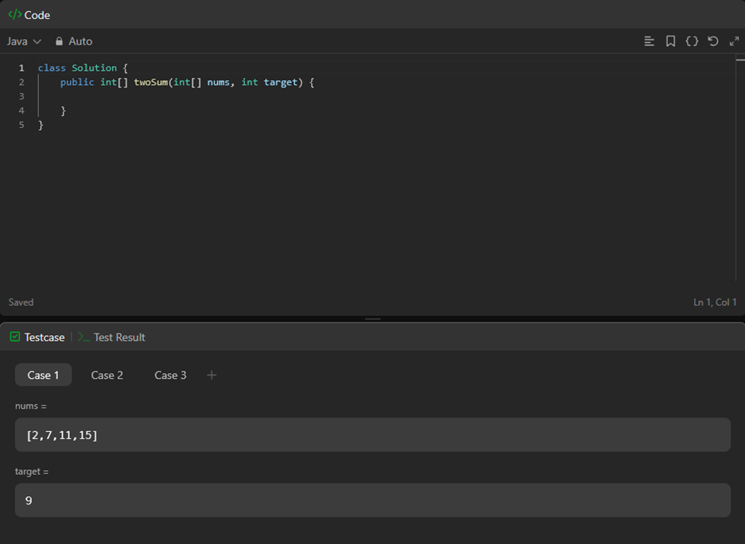
Testing
Test inputs + Code submission sent to docker container
Code executed inside docker container using test inputs
Container sends back return value and execution metadata
Return value is compared against expected output value
Results returned to user
How will you prevent hard coded solutions?
Sample Test Cases
Hidden Test Cases
Fig. 3. Skeleton function example Source: (LeetCode, 2024)

Slide 7
Project Progress
Completed
To do
Progress so far
Plan second iteration
Functional Spec : 90%
Research Document: 70%
Design Document: 5%
Refine Research Document
Begin Design Document
Start Development

Slide 8

Any Questions?
Thank you for Listening

Slide 9
References
LeetCode. (2024). Two Sum - LeetCode. [online] Available at: https://leetcode.com/problems/two-sum/description/.

